Slide 1
Database Design
CSIT882: Data Management Systems
Notes:
<!-- Neural, Brian, Male, British English. -->
<speak>
<break time="0.5s"/>
<prosody rate="90%">
Database Design.
This presentation provides a birds eye view of a database design process, and it also explains the concepts of database domain, database schema, and object modeling</prosody>
<break time="0.5s"/>
</speak>
1
Systems Analysis

Slide 2
Outline
Database Design Process
Database Domain
Database Schema
Object Modeling
2
Notes:
<!-- Neural, Brian, Male, British English. -->
<speak>
<break time="0.5s"/>
<prosody rate="90%">
Database Design Process.
<break time="0.3s"/>
</prosody>
</speak>
Systems Analysis
2

Slide 3
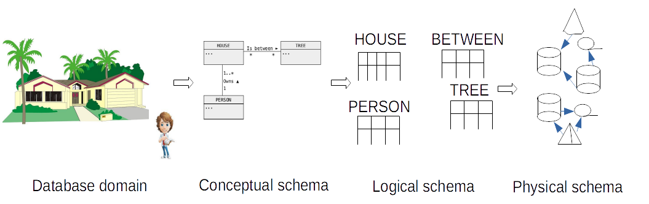
Database Design Process
A simplified process of database design consists of the following stages:
- Conceptual modeling
Conceptual modeling transforms a specification of a database domain into a conceptual schema 将语言描述转为概念模式
- Logical design
Logical design transforms a conceptual schema into a logical schema,
e.g. headers of relational tables 将概念模式转为逻辑模式
- Physical design物理设计
Physical design determines the implementation details and adds to a logical schema persistent storage structures that improve performance,
e.g. indexes, clusters, partitions, materialized views, etc
3
Notes:
<!-- Neural, Brian, Male, British English. -->
<speak>
<break time="0.5s"/>
<prosody rate="90%">
A simplified process of database design used in this subject, consists of the following stages: <break time="0.3s"/> conceptual modelling, logical design, and physical design.
<break time="0.3s"/>
A stage of conceptual modelling, transforms a specification of database domain into a conceptual schema.
<break time="0.3s"/>
Next, a stage of logical design, transforms a conceptual schema into a logical schema.
<break time="0.3s"/>
If a tabular data model is used as a logical view of a database, a conceptual schema is transformed into a set of so called relational schemas.
<break time="0.3s"/>
A relational schema consists of sequence of attributes located at a header of table with data.
<break time="0.3s"/>
Finally, a stage of physical design determines the implementation details, like for example, location of the tables with data on the persistent storage devices.
<break time="0.3s"/>
A picture at the bottom of the slide visualizes a process of database design.
<break time="0.3s"/>
A real estate agency would like to have a database with information about the real estate properties available for sale.
<break time="0.3s"/>
A database domain contains information about real estate properties, owners of the properties, and the specific features of the properties, like for example, a fact that a property is located among the trees.
<break time="0.3s"/>
In the first stage of a design, a database domain is more formally represented by a conceptual schema.
<break time="0.3s"/>
A conceptual schema is usually a diagram, that consists of the rectangular boxes representing classes of objects, labelled lines representing associations between the objects, and the attributes (properties) describing the classes of objects.
<break time="0.3s"/>
At a stage of logical design the classes of objects, association and attributes are transformed into the relational tables, that contain the rows with information about people (owners), houses, and locations of houses.
<break time="0.3s"/>
Finally, a stage of physical design determines the locations of tables on persistent storage devices, and the additional persistent storage structures like for example indexes or materialized views.
<break time="0.3s"/>
</prosody>
</speak>
Systems Analysis
3

Slide 4
Outline
Database Design Process
Database Domain
Database Schema
Object Modeling
4
Notes:
<!-- Neural, Brian, Male, British English. -->
<speak>
<break time="0.5s"/>
<prosody rate="90%">
Database Design Process.
<break time="0.3s"/>
</prosody>
</speak>
Systems Analysis
4

Slide 5
Database Domain 数据库域
A database domain is a selected fragment of the real world to be described by the contents of a database
数据库域是由数据库内容描述的现实世界的选定片段
For example, a typical simple business domain can be described as a sequence of statements:
- A company would like to store and to maintain information about its suppliers and the parts shipped by the suppliers
- A supplier is described by a supplier name, date of birth, salary, and city he/she lives in
- A part is described by a part number, part name, colour and price
- A shipment is described by a supplier number, part name and quantity ordered
- A supplier is identified by its supplier number and a part is identified by its part number
5
Notes:
<!-- Neural, Brian, Male, British English. -->
<speak>
<break time="0.5s"/>
<prosody rate="90%">
A database domain is a selected fragment of the real world, to be described by the contents of a database.
<break time="0.3s"/>
For example, a typical simple business domain can be described in the following short story.
<break time="0.3s"/>
A company would like to store and to maintain information about its suppliers and about the parts shipped by the suppliers.
<break time="0.3s"/>
A supplier is described by a supplier name, date of birth, salary and city he or she lives in.
<break time="0.3s"/>
A part is described by a part number, part name, colour and price.
<break time="0.3s"/>
A shipment is described by a supplier number, part name and quantity ordered.
<break time="0.3s"/>
A supplier is identified by its supplier number and a part is identified by its part number.
<break time="0.3s"/>
</prosody>
</speak>
Systems Analysis
5

Slide 6
Outline
Database Design Process
Database Domain
Database Schema
Object Modeling
6
Notes:
<!-- Neural, Brian, Male, British English. -->
<speak>
<break time="0.5s"/>
<prosody rate="90%">
Database Schema.
</prosody>
</speak>
Systems Analysis
6

Slide 7
Database Schema
A database schema is a description of stored data expressed in the terms of a particular data abstraction level
A conceptual schema is a description of stored data expressed in the terms of classes objects, properties of objects, identifiers of classes of objects, associations between the classes of objects and the others
A logical schema is a description of stored data expressed in the terms of attributes, values of attributes, rows, columns, headers and tables
A physical schema is a description of stored data expressed in the terms of files, indexes, clusters, data blocks and the others
数据库模式是以特定数据抽象层次表达的存储数据描述
概念模式是对存储数据的描述，用类对象、对象属性、类对象标识符、类对象与其他对象之间的关联来表示
逻辑模式是对存储数据的描述，用属性、属性值、行、列、页眉和表格表示
物理模式是对存储数据的描述，用文件、索引、群组、数据块等术语表示
7
Notes:
<!-- Neural, Brian, Male, British English. -->
<speak>
<break time="0.5s"/>
<prosody rate="90%">
A database schema is a description of stored data expressed in the terms of a particular data abstraction level.
<break time="0.3s"/>
For example, at the highest level of abstraction, the data structures are described by a conceptual schema.
<break time="0.3s"/>
A conceptual schema is a description of stored data expressed in the terms of classes objects, properties of objects, identifiers of classes of objects, associations between the classes of objects and the others.
<break time="0.3s"/>
At the middle level, the data structures are described by a logical schema.
<break time="0.3s"/>
A logical schema is a description of stored data expressed in the terms of attributes, values of attributes, rows, columns, headers and tables.
<break time="0.3s"/>
At the lowest level, the data structures are described by a physical schema.
<break time="0.3s"/>
A physical schema is a description of stored data expressed in the terms of files, indexes, clusters, data blocks, and the others.
<break time="0.3s"/>
</prosody>
</speak>
Systems Analysis
7

Slide 8
Outline
Database Design Process
Database Domain
Database Schema
Object Modeling
8
Notes:
<!-- Neural, Brian, Male, British English. -->
<speak>
<break time="0.5s"/>
<prosody rate="90%">
Object Modeling.
<break time="0.3s"/>
</prosody>
</speak>
Systems Analysis
8

Slide 9
Object Modeling对象建模
Object modeling is a special kind of conceptual modeling where a specification of database domain is transformed into a simplified class diagram (conceptual schema)
Principles of object modeling:
- Contents of a database is quantised into discrete objects
- Objects are described by the attributes (properties) and the operations (methods)
- Good news: we ignore operations !
- Objects are identified by the values of selected attributes
- A class of objects is a group of homogeneous objects with common properties, common semantics and common identifiers-
数据库内容被量化为离散对象
- 对象由属性（属性）和操作（方法）描述
- 好消息：我们忽略操作！
- 对象通过所选属性的值来识别
- 对象类是一组具有共同属性、共同语义和共同标识符的同质对象
9
Notes:
<!-- Neural, Brian, Male, British English. -->
<speak>
<break time="0.5s"/>
<prosody rate="90%">
The object modeling is a special kind of conceptual modeling, where a specification of database domain is transformed into a simplified class diagram (conceptual schema).
<break time="0.3s"/>
The principles of Object Modeling are the following:
<break time="0.3s"/>
Contents of a database is quantised into discrete objects.
<break time="0.3s"/>
Objects are described by the attributes (properties) and the operations (methods).
<break time="0.3s"/>
There is no need to represent the operations on objects and attributes.
<break time="0.3s"/>
Objects are identified by the values of selected attributes.
<break time="0.3s"/>
A class of objects is a group of homogeneous objects with common properties, common semantics and common identifiers.
<break time="0.3s"/>
</prosody>
</speak>
Systems Analysis
9

Slide 10
Object Modeling
Examples:
- A student is an object, a lecturer is an object, a lecture hall is an object, a shipment is an object, an accident is an object and so on
- A student is described by the attributes student number, first name, last name, date of birth and the others
- A student is identified by a student number, a lecture hall is identified by a pair of attributes (building number, room number), a shipment is identified by a triple of attributes (supplier name, date, time)
- A group of students forms a class of objects STUDENT, a group of lecturers forms a class of objects LECTURER, a group of shipments forms a class of objects SHIPMENT
10
Notes:
<!-- Neural, Brian, Male, British English. -->
<speak>
<break time="0.5s"/>
<prosody rate="90%">
Here are few examples of the concepts introduced on the previous slide.
<break time="0.3s"/>
A student is an object, a lecturer is an object, a lecture hall is an object, a shipment is an object, an accident is an object and so on.
<break time="0.3s"/>
A student is described by the attributes like student number, first name, last name, date of birth and the others.
<break time="0.3s"/>
A student is identified by a student number, a lecture hall is identified by a pair of attributes, building number and room number, a shipment is identified by a triple of attributes, supplier name, date and time.
<break time="0.3s"/>
A group of students forms a class of objects STUDENT, a group of lecturers forms a class of objects LECTURER, a group of shipments forms a class of objects SHIPMENT.
<break time="0.3s"/>
</prosody>
</speak>
Systems Analysis
10

Slide 11
Object Modeling
More object modeling concepts:
- A link is a conceptual connection between two or more objects
- An association represents a group of homogeneous links with a common structure, common attributes, common semantics and common identifiers
Examples of links:
- James talks to Janusz
- Lecture 1 in Database Systems is in building 3 room 2
- Peter supplies bolts to James
Examples of associations:
- STUDENT Talks-to LECTURER
- LECTURE Is-in BUILDING
- SUPPLIER Supplies PART to MANUFACTURER
11
Notes:
<!-- Neural, Brian, Male, British English. -->
<speak>
<break time="0.5s"/>
<prosody rate="90%">
Now we define a few more object modeling concepts.
<break time="0.3s"/>
A link is a conceptual connection between two or more objects.
<break time="0.3s"/>
An association represents a group of homogeneous links with a common structure, common attributes, common semantics and common identifiers.
<break time="0.5s"/>
Few examples of links.
<break time="0.3s"/>
James talks to Janusz
<break time="0.3s"/>
Lecture 1 on Database Systems is in Building 3, Room 2.
<break time="0.3s"/>
Peter supplies bolts to James
<break time="0.5s"/>
Few, examples of associations.
<break time="0.3s"/>
STUDENT Talks-to LECTURER.
<break time="0.3s"/>
LECTURE Is in BUILDING.
<break time="0.3s"/>
SUPPLIER Supplies PART to MANUFACTURER.
<break time="0.3s"/>
</prosody>
</speak>
Systems Analysis
11

Slide 12
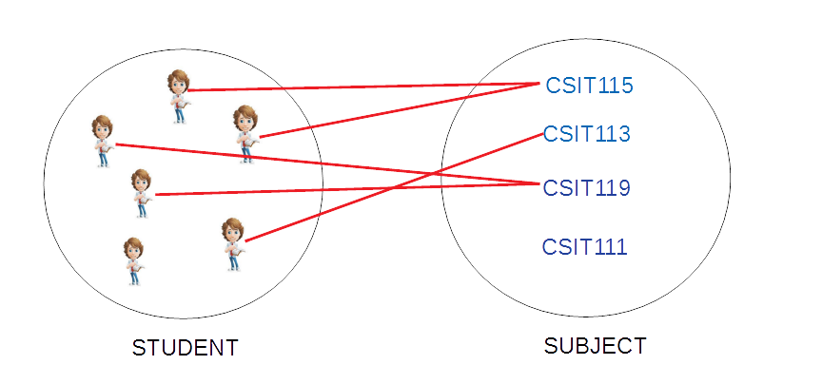
Object Modeling
Visualizations of objects, links, classes, and associations
12
Notes:
<!-- Neural, Brian, Male, British English. -->
<speak>
<break time="0.5s"/>
<prosody rate="90%">
The following diagram visualises the concepts of objects, links, classes of objects and associations.
<break time="0.3s"/>
A class of objects STUDENT consists of 6 objects (students).
<break time="0.3s"/>
An object in a class STUDENT is a student.
<break time="0.3s"/>
A class SUBJECT consists of four subjects C S I T 1 1 5, C S I T 1 1 3, C S I T 1 1 9, and C S I T 1 1 1.
<break time="0.3s"/>
The links connect students and subjects.
<break time="0.3s"/>
A link between a student and a subject represents a fact, that a student enrolled that or other subject.
<break time="0.3s"/>
A collection of all links between the students and the subjects forms an association Enrols.
<break time="0.3s"/>
A diagram visualises a database domain where the students enrol in the subjects.
<break time="0.3s"/>
</prosody>
</speak>
Systems Analysis
12

Slide 13
Object Modeling
More object modeling concepts:
- A generalisation hierarchy represents Is-a-subset relation between the classes of objects
- If a set of all objects in a class X is a subset of a set of all objects in a class Y then class Y is a generalization of class X
- In the other words, if a class Y is a generalization of class X then a set of all objects in Y includes a set of all objects in X
Example of generalisation:
- A class STUDENT is a generalization of classes UNDERGRADUATE STUDENT and POSTGRADUATE STUDENT
- This is so because a set of all undergraduate students is a subset of a set of all students and a set of all postgraduate students is a subset of a set of all students
- In the other words, a set of all students includes a set of all postgraduate students and it also includes a set of all undergraduate students
概括举例- 类STUDENT是类,
UNDERGRADUATE STUDENT 和 POSTGRADUATE STUDENT 的泛化
之所以如此，是因为所有本科生的集合是所有学生集合的子集，所有研究生的集合是所有学生集合的子集- 换句话说，所有学生的集合包括所有研究生的集合，也包括所有本科生的集合
13
Notes:
<!-- Neural, Brian, Male, British English. -->
<speak>
<break time="0.5s"/>
<prosody rate="90%">
Now, we again define a few more object modeling concepts.
<break time="0.3s"/>
A generalisation hierarchy represents Is-a-subset relation between the classes of objects.
<break time="0.3s"/>
If a set of all objects in a class X is a subset of a set of all a objects in a class Y, then class Y is a generalization of class X.
<break time="0.3s"/>
In other words, if class Y is a generalisation of class X, then a set of all objects in Y includes a set of all objects in X.
<break time="0.5s"/>
Here are a few examples of generalisation.
<break time="0.3s"/>
A class STUDENT is a generalization of classes UNDERGRADUATE STUDENT and POSTGRADUATE STUDENT.
<break time="0.3s"/>
This is because, a set of all undergraduate students is a subset of a set of all students, and a set of all postgraduate students is a subset of a set of all students.
<break time="0.3s"/>
In the other words, a set of all students includes a set of all postgraduate students, and it also includes a set of all undergraduate students
<break time="0.3s"/>
</prosody>
</speak>
Systems Analysis
13

Slide 14
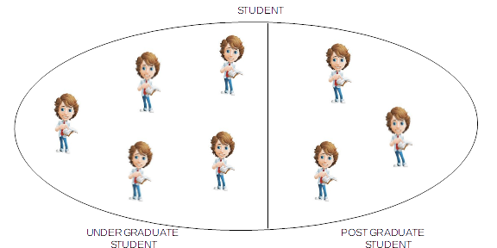
Object Modeling
Visualizations of generalizations UNDERGRADUATE STUDENT ISA STUDENT and POSTGRADUATE STUDENT ISA STUDENT
14
Notes:
<!-- Neural, Brian, Male, British English. -->
<speak>
<break time="0.5s"/>
<prosody rate="90%">
The following diagram visualises the concepts of classes of objects and generalization of classes of objects.
<break time="0.3s"/>
A class student is a generalization of the classes of undergraduate and postgraduate students.
<break time="0.3s"/>
This is because every undergraduate student is a student, and every postgraduate student is a student as well.
<break time="0.3s"/>
As it is visible on the diagram a class of undergraduate students is a subset of a class of students, and a class of postgraduate students is also a subset of a class of students.
<break time="0.3s"/>
</prosody>
</speak>
Systems Analysis
14

Slide 15
Object Modeling
Another example of generalisation:大的是小的的泛化
- A class HUMAN is a generalisation of classes STUDENT and LECTURER
- This is so because a set of all students is a subset of a set of all humans and a set of all lecturers is a subset of a set of all humans
- In other words, a set of all humans includes a set of all students and it also includes a set of all lecturers
Yet another (and it is my favorite) example of generalization:
- A class BAT is a generalization of classes GREY-BAT, VAMPIRE-BAT and BATMAN
- This is so because a set of all grey bats is a subset of a set of all bats and a set of all vampire bats is a subset of a set of all bats and a set of all batmen is a subset of a set of all bats
15
Notes:
<!-- Neural, Brian, Male, British English. -->
<speak>
<break time="0.5s"/>
<prosody rate="90%">
A few more examples of generalisation.
<break time="0.3s"/>
A class HUMAN is a generalization of classes STUDENT and LECTURER.
<break time="0.3s"/>
This is so because a set of all students is a subset of a set of all humans, and a set of all lecturers is a subset of a set of all humans
<break time="0.3s"/>
In other words, a set of all humans includes a set of all students, and it also includes a set of all lecturers (what some students do not believe that it is possible).
<break time="0.3s"/>
Yet another (and it is my favorite) example of generalization.
<break time="0.3s"/>
A class BAT is a generalization of classes GREY-BAT, VAMPIRE-BAT, and BATMAN
<break time="0.3s"/>
This is so because a set of all grey bats is a subset of a set of all bats, and a set of all vampire bats is a subset of a set of all bats,
and a set of all batmen is a subset of a set of all bats.
<break time="0.3s"/>
</prosody>
</speak>
Systems Analysis
15

Slide 16
References
C. Coronel, S. Morris, A. Basta, M. Zgola, Data Management and Security, Chapter 2, Cengage Compose eBook, 2018, eBook: Data Management and Security, 1st Edition
T. Connoly, C. Begg, Database Systems, A Practical Approach to Design, Implementation, and Management, Chapter 10 Database System Development Cycle, Pearson Education Ltd, 2015
16
Notes:
<!-- Neural, Brian, Male, British English. -->
<speak>
<break time="0.5s"/>
<prosody rate="90%">
References.
<break time="0.5s"/>
</prosody>
</speak>
Systems Analysis
16

